Slide 1
EZ ONE REPORTs FOR YEAR END
Laura bowers, chief deputy auditor-controller

Slide 2
AGENDa
EZ ONE reports
Revenue and Expenditure Budget to Actual
Budget control
EZ ONE Training Materials

Slide 3
BUDGET CONTROL
Special District budgets are normally controlled at the GL key, and the character level

Slide 4
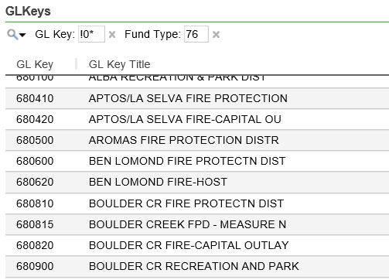
BUDGDET CONTROL
Example GL keys

Slide 5
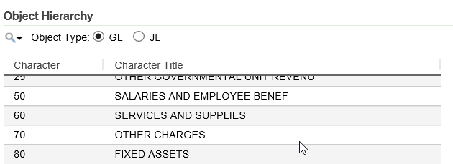
BUDGET CONTROL
Character examples are as follows:

Slide 6
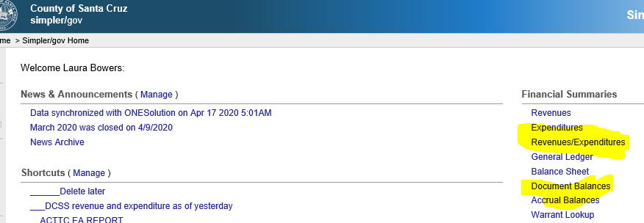
EZ ONE BUDGET TO ACTUAL REPORT
Click Revenues/Expenditures under Financial summaries

Slide 7
EZ ONE BUDGET TO ACTUAL REPORT
From ‘As Of’ drop down, select ‘yesterday’ for most up-to date transactions, then click ok

Slide 8
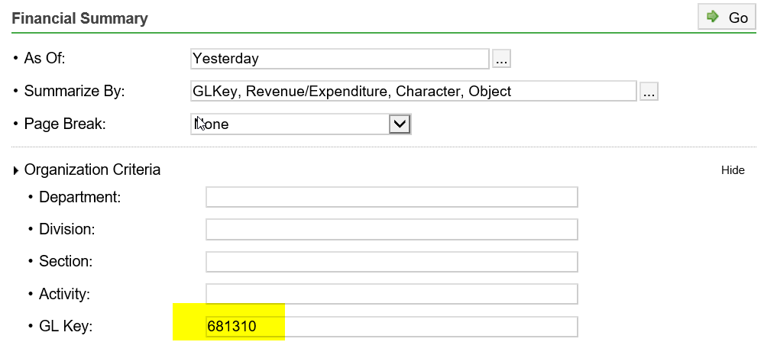
EZ ONE BUDGET TO ACTUAL REPORT
Option 1 - Enter gl key in gl key field OR

Slide 9
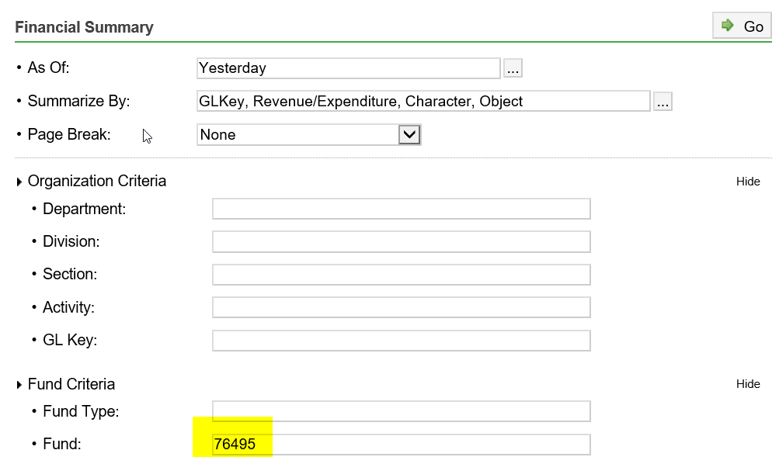
EZ ONE BUDGET TO ACTUAL REPORT
Option 2 - Enter fund number in in fund field – this is preferred for special districts with multiple GL keys

Slide 10
EZ ONE BUDGET TO ACTUAL REPORT
Scroll to the very bottom of the screen and select ‘show’ to the right of advanced options

Slide 11
EZ ONE BUDGET TO ACTUAL REPORT
Click on the ‘builder’ next to the columns field

Slide 12
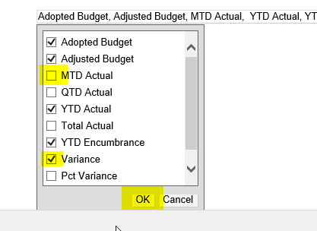
EZ ONE BUDGET TO ACTUAL REPORT
Remove the ‘MTD Actual’ checkmark and add a checkmark to ‘Variance’ and click ‘OK’

Slide 13
EZ ONE BUDGET TO ACTUAL REPORT
Scroll back to the top of the select GL Key for Page Break

Slide 14
EZ ONE BUDGET TO ACTUAL REPORT
click ‘Go’ to run the query

Slide 15
EZ ONE BUDGET TO ACTUAL REPORT
Resulting report should look like this:

Slide 16
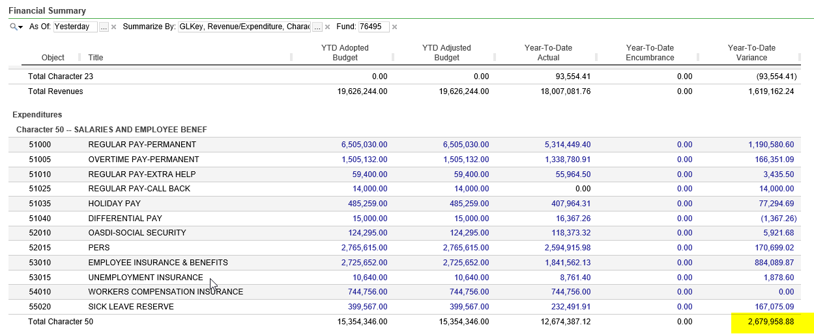
EZ ONE BUDGET TO ACTUAL REPORT
Note, the variance column for each character shows how much budget is not received yet (for revenues) or is remaining (for expenditures) for each character:

Slide 17
NEXT STEP
Save shortcut if you don’t have a shortcut for this report already (refer to EZ ONE training materials)

Slide 18
EZ ONE TRAINING MATERIALS

Slide 19
EZ ONE TRAINING MATERIALS

